Slide 1

Fundamentals of Data Science - Winter 2023-24
Final Project – 1st Presentation – Nov 27th, 2023
E. Mokhtari, A. Bakhshaee, S. S. Parsa, A. Zabihi, O. Ghorbani

Slide 2

Analyzing Kobe Bryant's Shot Success Using Logistic Regression
Task Statement:
Developing a model using logistic regression to predict shot success of a basketball player using the Kobe Bryant Shot Selection dataset
Motivation:
Motivated by the potential to uncover the underlying patterns in Bryant's shooting strategy.
Coaching strategies, player performance evaluation, and game analysis.
Related Works:
Kaggle competition (https://www.kaggle.com/competitions/kobe-bryant-shot-selection/overview)
Sapienza University of Rome – FDS (W23/24) – Final Project – 27/11/2023
Notes:
Task Statement: "The project aims to develop a predictive model using logistic regression to analyze the shot success of Kobe Bryant, one of the NBA's legendary basketball players. By examining various shot features such as location coordinates, shot distance, and game context variables, the model will attempt to predict the likelihood of a shot being successful."
Motivation: "This analysis is motivated by the potential to uncover the underlying patterns in Bryant's shooting strategy, contributing to the broader field of sports analytics. Understanding these patterns can offer coaches and players insights into effective shooting techniques and game strategies. Moreover, this model can serve as a foundation for future studies on performance analytics in sports, offering a methodological approach for other data-driven sports performance analyses. It demonstrates the application of logistic regression in a practical scenario, aligning with the growing intersection of data science and sports."

Slide 3
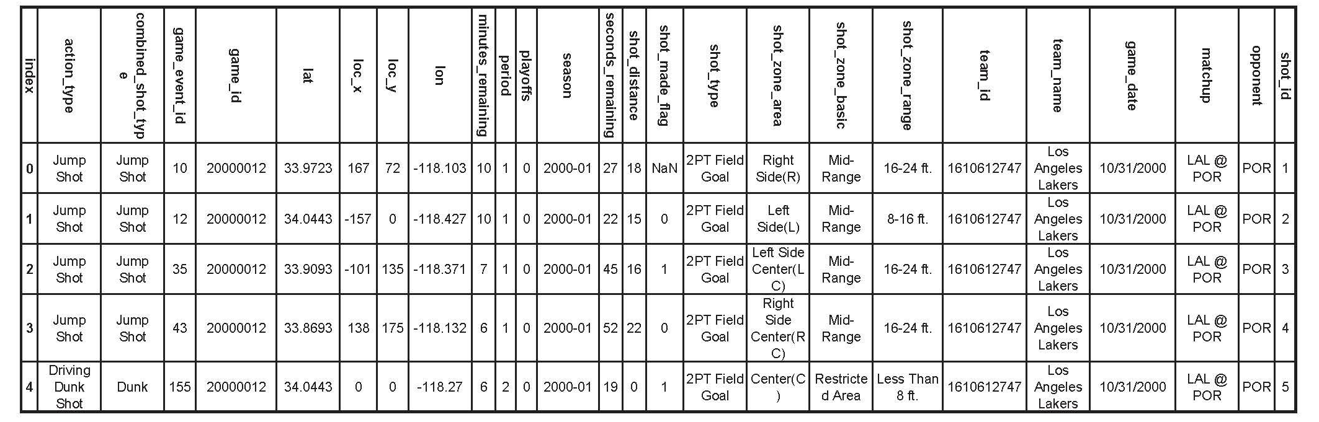
Analyzing Kobe Bryant's Shot Success Using Logistic Regression
Dataset sample
Sapienza University of Rome – FDS (W23/24) – Final Project – 27/11/2023

Slide 4
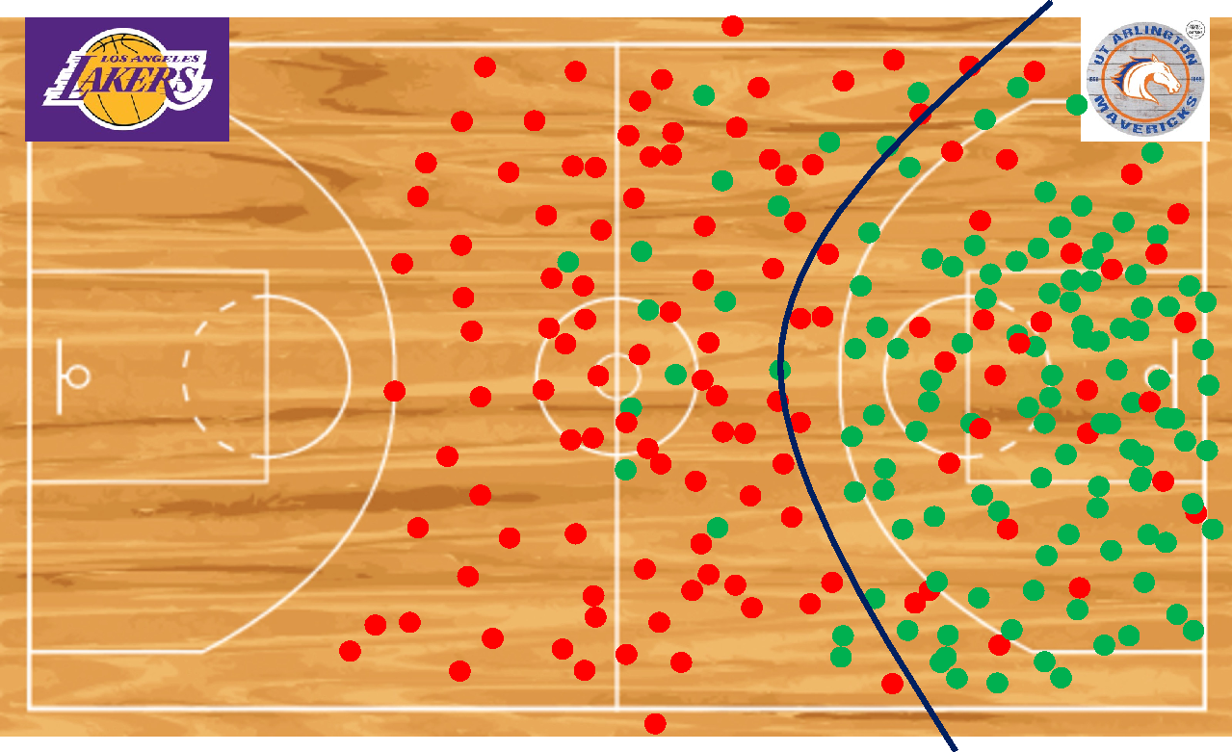
Analyzing Kobe Bryant's Shot Success Using Logistic Regression
Models:
Logistic Regression: binary classification task
Model Training: historical shot data
Data exploration:
• Understanding the dataset, visualizations (e.g., heatmaps, shot charts)
Feature engineering:
Spatial: shot distance, angle, and proximity to the basket.
Temporal: shot clock, quarter, and game time.
Player-Specific: Kobe's historical performance, playing style, and hot zones.
• Variables Coefficient: Regularization methods
Tools:
Programming Language: Python; pandas, numpy for data manipulation, Model development in scikit-learn's with logistic regression module.
Complexity
Sapienza University of Rome – FDS (W23/24) – Final Project – 27/11/2023
Notes:
We use the dataset already provided on a Kaggle competition.
It includes a lot of features, but we are going to use only the most relevant ones.
In phase 1, we try to keep it simple. As you can see in the figure of the basketball court, there should be a specific relation between the location of the shot, and whether it was successful or not. We can use a polynomial logistic regression model to create a decision boundary function. For simplicity, this figure is just for one given moment.
The time remaining is also important, because it can give us data about whether a player is most successful/productive at the start or in the middle, or at the end...
In order to make the model more accurate, We can also increase the complexity by adding other features, such as shot_distance, opponent, and Game_date. Of course, we will have to do something about the opponent feature, because it isn’t numerical.
There are various methods we can use. Obviously our 1st choice in logistic regression. We can use the batch method of gradient ascent to analyse the whole training set at once. Or we can use the stochastic method, or something in between (mini-batches).
We can also use SVM or NN (neural networks) to compare and contrast the accuracy and computational complexity of the different models.

Slide 5
Analyzing Kobe Bryant's Shot Success Using Logistic Regression
Evaluation:
Data Splitting: training (70-80%) and testing (20-30%) sets with a representative distribution of shots.
Cross-Validation: k-fold cross-validation for model stability and generalization across different subsets of the dataset.
Metrics:
Performance Metrics:
Accuracy: Overall correctness of predictions.
Precision: Proportion of correctly predicted successes among all predicted successes.
Recall: Proportion of correctly predicted successes among all actual successes.
F1 Score: Harmonic mean of precision and recall, providing a balanced evaluation.
Benchmarking:
• Compare the model's performance against models developed with other ML algorithms, e.g. SVM.
• Compare with other models on kaggle
• If possible, retrieve similar data for other players from https://www.nba.com/stats & test the performance
Sapienza University of Rome – FDS (W23/24) – Final Project – 27/11/2023

Slide 6
Thank you for your attention!

